Slide 1
Lecture 11: Tuples
Senior lectures: Vladislav Karyukin

Slide 2
Tuples
Tuples and lists are both data structures in Python that are used to store collections of items.
They are similar to each other but have some key differences.
Here are some characteristics of tuples

Slide 3
Features of tuples
Immutable: Once a tuple is created, its elements cannot be changed, added, or removed. This is the main difference between tuples and lists, which are mutable.
Ordered: Like lists, tuples maintain the order of their elements. This means you can access elements using their index, and slicing works similarly as well.
Syntax: Tuples are defined by enclosing the elements in parentheses () and separating them with commas.
Versatile: Tuples can hold any type of data, and they can also contain a mix of different data types. Additionally, tuples can be nested, meaning a tuple can contain other tuples as elements.
Use Cases: Due to their immutability, tuples are often used to represent fixed collections of items, such as coordinates (x, y, z) or to ensure that data remains constant throughout the program. They are also commonly used as keys in dictionaries because they are hashable, unlike lists.

Slide 4
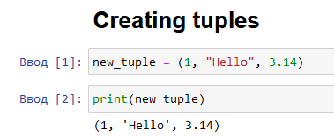
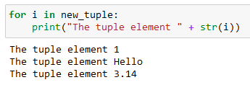
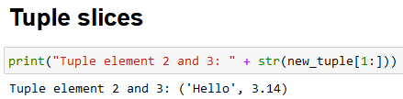
Tuples Python code

Slide 5


Nested tuples
Here are some examples of nested tuples:
Tuples of Lists: A tuple containing lists as its elements.

Slide 6

Mixed tuples
A tuple containing a mix of different data types, including lists, tuples, dictionaries, and other data types.

Slide 7

Operations with tuples
Although the tuple’s elements are not changed, there are some available operations with them.
Accessing Elements: You can access individual elements of a tuple using indexing.

Slide 8

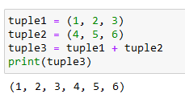
Operations with tuples
Slicing: You can use slicing to get a subset of a tuple.
Concatenation: You can concatenate two or more tuples to create a new tuple.

Slide 9


Operations with tuples
Repetition: You can repeat a tuple a specified number of times using the * operator
Membership Testing: You can check if an element exists in a tuple using the in operator

Slide 10



Operations with tuples
Length: You can find the length of a tuple using the len() function
Count: You can count the number of occurrences of a specific element in a tuple using the count() method
Nested Tuples: You can create tuples that contain other tuples

